Slide 1
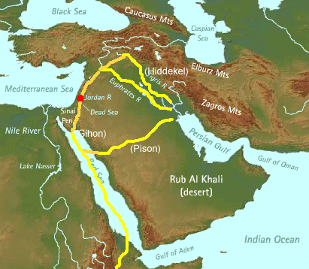
The Geography of the Garden of Eden & the Ancient Near East
Dr. Rick Griffith • Jordan Evangelical Theological Seminary • BibleStudyDownloads.org

Slide 2

The World Today

Slide 3


Modern Middle East
21

Slide 4
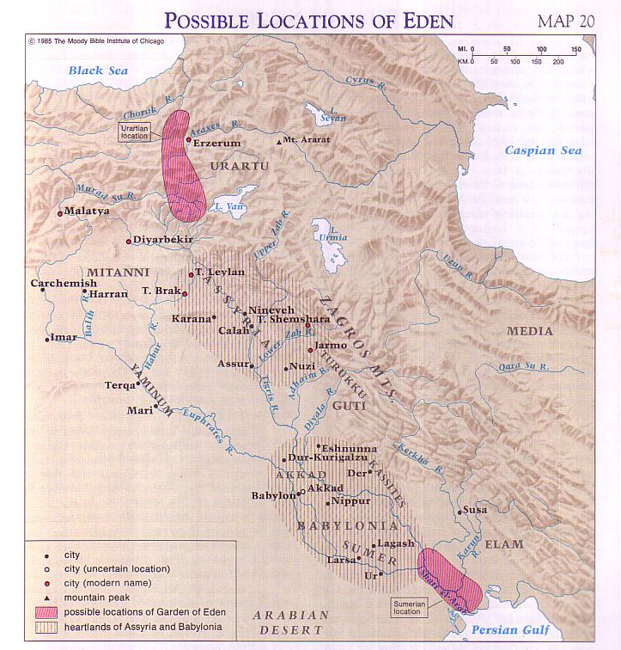
Two Suggested Locations of Eden
21
Barry Beitzel, Moody Atlas of Bible Lands, 75
Genesis 2:10-14
Eden
Mt Ararat
Tigris
Euphrates
Gihon?
(Ethiopia)
Pishon?
(Saudi Arabia)
Notes:
We don't know the exact location of Eden as it was destroyed later in the Flood.
——————
BG-02-Eden&ANE-4
OS-01-Gen1-3-slide158
OS-01-Gen4-20-slide 119
OS-23_Isaiah13-23-slide 73

Slide 5

Mesopotamian Cush First Noted in Genesis 2
457
Eden
Pishon
Gihon
Havilah?
Cush?
“A river flowed from the land of Eden, watering the garden and then dividing into four branches. ¹¹The first branch, called the Pishon, flowed around the entire land of Havilah, where gold is found. ¹²The gold of that land is exceptionally pure; aromatic resin and onyx stone are also found there. ¹³The second branch, called the Gihon, flowed around the entire land of Cush” (Genesis 2:10-13 NLT)
Egypt
Sudan
Notes:
Ancient Cush overlapped present Libya, Egypt, and Sudan as seen on the next slide.
————
Cush in the OT (NLT version):
Gen. 2:13 The second branch, called the Gihon, flowed around the entire land of Cush.
Gen. 10:6 The descendants of Ham were Cush, Mizraim, Put, and Canaan.
Gen. 10:7 The descendants of Cush were Seba, Havilah, Sabtah, Raamah, and Sabteca. The descendants of Raamah were Sheba and Dedan.
Gen. 10:8 Cush was also the ancestor of Nimrod, who was the first heroic warrior on earth.
1Chr. 1:8 The descendants of Ham were Cush, Mizraim,ª Put, and Canaan.
1Chr. 1:9 The descendants of Cush were Seba, Havilah, Sabtah, Raamah, and Sabteca. The descendants of Raamah were Sheba and Dedan. ¹⁰ Cush was also the ancestor of Nimrod, who was the first heroic warrior on earth.
Psa. 7:0 A psalmª of David, which he sang to the LORD concerning Cush of the tribe of Benjamin.
——————
BG-02-Eden&ANE-5
OS-01-Gen1-3-slide 159
OS-01-Gen4-20-slide 121
OS-23_Isaiah13-23-slide 73

Slide 6
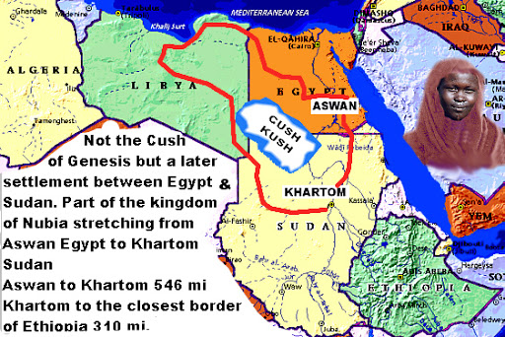
Correct Location of Cush
Cush
This is not the Cush of Genesis but a later settlement between Egypt and Sudan as part of Nubia stretching from Aswan, Egypt to Khartoum, Sudan
http://arab-israelites.tripod.com/cush2.htm
Notes:
We often think of ancient Cush as covering modern Ethiopia, but this map says otherwise as it does not even include a part of Ethiopia.
——————
BG-02-Eden&ANE-6
OS-01-Gen1-3-slide160
OS-01-Gen4-20-slide 121
OS-23_Isaiah13-23-slide 76

Slide 7

Rodinia––The World That Perished
The transformation of Adam's world into today's world
Notes:
Creationists and evolutionists alike agree that the world originally was a single continent. Genesis 1:9-10 supports this idea, “Then God said, ‘Let the waters beneath the sky flow together into one place, so dry ground may appear.’ And that is what happened. ¹⁰ God called the dry ground ‘land’ and the waters ‘seas.’ And God saw that it was good.”
——————
BG-02-Eden&ANE-7
OS-01-Gen1-3-slide161
OS-01-Gen4-20-slide 122
OS-23_Isaiah13-23-slide 77

Slide 8

THE WORLD THAT PERISHED
The transformation of Adam's world into today's world
Notes:
This slide from Answers in Genesis shows the original Rodinia breaking up into Pangaea and then transitioning into our continental configuration today. This process took about a year.
——————
BG-02-Eden&ANE-8
OS-01-Gen1-3-slide161
OS-01-Gen4-20-slide 122
OS-23_Isaiah13-23-slide 77

Slide 9
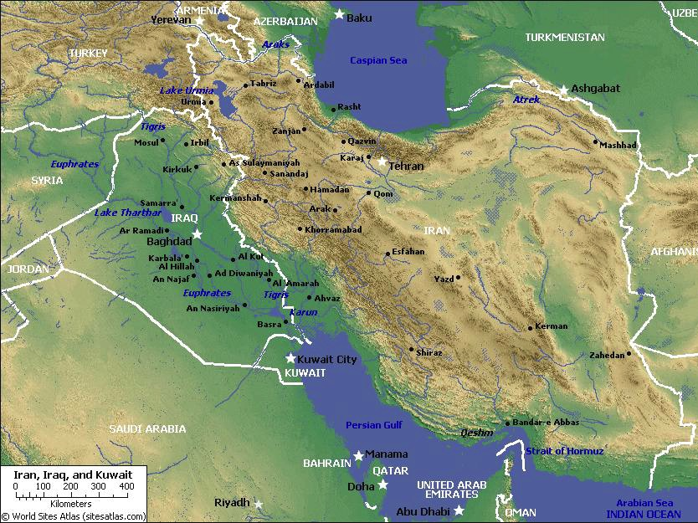
Mesopotamia
21
Tigris
Assyria
Euphrates
Babylon
Persia
Chaldea
Persian Gulf

Slide 10

The Ancient Near East
21
Fertile Crescent
Iraq
Israel
Egypt

Slide 11
7
Genesis 12
The Lord had said to Abram,
“Leave your country, your people and your father's household, and go to the land I will show you.
1
“I will make you into a great nation
and I will bless you;
I will make your name great,
and you will be a blessing.
2
ABRAHAM
The CALL
I will bless those who bless you,
and whoever curses you I will curse;
and all peoples on earth
will be blessed through you.”
L - S - B
3
Handbook pg. 19-24
14
3
Notes:
In Genesis 12, verses 1-3 present God's three-part promise to Abraham. Here it is:
//// The Lord had said to Abram,
“Leave your country, your people and your father's household, and go to THE LAND I will show you.
//// “I will make you into A GREAT NATION
and I will bless you;
I will make your name great,
and you will be a blessing.
//// I will bless those who bless you,
and whoever curses you I will curse;
and ALL PEOPLES ON EARTH
WILL BE BLESSED THROUGH YOU.”

Slide 12
7
Genesis 12
The Lord had said to Abram,
“Leave your country, your people and your father's household, and go to the land I will show you.
1
A LAND
A SEED
“I will make you into a great nation
and I will bless you;
I will make your name great,
and you will be a blessing.
2
ABRAHAM
The CALL
I will bless those who bless you,
and whoever curses you I will curse;
and all peoples on earth
will be blessed through you.”
L - S - B
3
A BLESSING
Handbook pg. 19-24
15
3
Notes:
The order of those covenant promises is an important key to Biblical order itself:
//// First is the promise of a LAND…then…
//// a SEED
//// followed by a BLESSING, represented by “L-S-B” on the ABRAHAM file folder.

Slide 13

The Abrahamic Covenant
(“The Call”)
Genesis 12:1-3
ABRAHAM
LAND
SEED
BLESSING
The CALL
L - S - B
12:1
12:2
12:3
“L-S-B”
Handbook pg. 19-24
16
3
Notes:
Now study this plan of organization…the down-to-earth meaning of those three promises…the L-S-B on ABRAHAM's folder…
//// First…PROMISE #1: GENESIS 12:1...A LAND — real estate, a geographic inheritance that most Jewish people respect politically to this present day.
//// PROMISE #2: GENESIS 12:2...A SEED — a long line of descendants...especially interesting because at the time the Promise is given, ABRAHAM and SARAH are approaching old age and yet they have never had children.
//// The final PROMISE, Number 3: GENESIS 12:3...A BLESSING promised to Abraham personally and to his descendants. Furthermore, God promises that, through His blessing to ABRAHAM, all the families of the earth will be blessed…NOT JUST ABRAHAM'S descendants! Notice that wording! It's important to an understanding of GRACE!

Slide 14
The Abrahamic Covenant
(“The Call”)
Genesis 12:1-3
Three Overriding Characteristics!
ABRAHAM
LAND
SEED
BLESSING
The CALL
L - S - B
• LITERAL
• ETERNAL
• UNCONDITIONAL
17
3
Notes:
Now...to the basic outline of the promise...L-S-B-...for LAND, SEED, and BLESSING...we can also add these basic concepts...three additional ideas that describe the characteristics of that Abrahamic Promise...
//// First…that great promise was -- and is -- LITERAL in that the words mean exactly what they say.
//// It is also ETERNAL, an unending arrangement, guaranteed by the maker of the contract, God Himself. And finally...
//// It is UNCONDITIONAL...indicating that no matter what Abraham or his descendants might do in the future, God would, in time…REPEAT: IN TIME…fulfill every element of His promises.
As we move farther through this story, we'll come to see how the entire Bible is built on that set of unconditional and foundational promises.... soon to become a legal contract between God and his friend, Abraham.

Slide 15
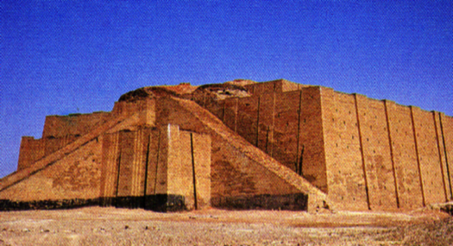
Gen. 11:31
DRESSING
THE
STAGE
THEY LEFT
IN
FAITH!
MS
N(A)
H
SG
C
R
B
J
MN
ABRAHAM
DS
The CALL
L - S - B
E
KB
U
MS
PG
RS
Handbook pg. 19-24
18
2
Notes:
After Abraham receives God's Promises…the entire family leaves Ur of the Chaldees to follow the Lord's direction.
//// They move toward the northwest with all their flocks and their possessions -- probably a large congregation of people, animals and tents. Biblical evidence shows ABRAHAM's family was probably wealthy. Again, if you have the map, add to it the map tracing that you see here in bright yellow. The main point here is this:
//// ABRAHAM and his family LEFT IN FAITH! They are moving toward a land that God will show them in due time. But as they leave Ur of the Chaldees they DO NOT know their destination. Their obedience is a profound demonstration of their faith in God's provision and His total protection as they head out into the unknown under Abraham's leadership.

Slide 16

Gen. 11:31-32
DRESSING
THE
STAGE
MS
N(A)
H
SG
C
ER
B
J
MN
ABRAHAM
DS
The CALL
L - S - B
E
KB
U
The Great City of Babylon
MS
PG
RS
Handbook pg. 19-24
19
Notes:
It is entirely possible that they passed through the region of ancient Babylon, upriver from Ur...that city to which you'll learn that Abraham's descendants – the Jews -- would be held as prisoners in the centuries to follow.

Slide 17
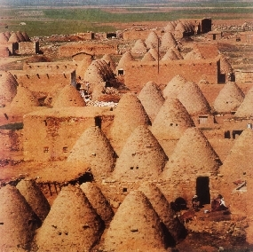
Gen. 11:31-32
DRESSING
THE
STAGE
MS
N(A)
H
THE FATHER, OLD TERAH, DIES AT HARAN.
SG
C
ER
B
J
MN
ABRAHAM
DS
The CALL
L - S - B
E
KB
U
MS
PG
The “Bee-Hive” City of Harran (Turkey) Today
RS
Handbook pg. 19-24
20
1
Notes:
They continue northwestward, finally arriving at ancient Haran…
… still in existence today in modern Turkey.
//// While settled temporarily in Haran, ABRAHAM's father, Terah, dies.

Slide 18
Gen. 12:5
DRESSING
THE
STAGE
MS
N(A)
H
SG
C
ER
B
J
MN
ABRAHAM
DS
The CALL
L - S - B
E
KB
U
MS
PG
RS
Handbook pg. 19-24
21
Notes:
Once again, God speaks to ABRAHAM, instructing him to now leave Haran and to move onward toward The Land He had promised to show him. That land is to be Canaan, or the land we call Israel today.

Slide 19

7
When Abraham enters The Land…
He is already 75 years old…
His wife, Sarah, is 65.
And yet…children are promised!
ABRAHAM
The CALL
L - S - B
Handbook pg. 19-24
22
4
Notes:
Now the great stage is set!
//// When he enters The Land,
//// ABRAHAM is already 75 years old and
//// his wife, Sarah, is 65.
//// And yet, God has promised them children? What?
Was God teasing the old couple? Children promised at that age?

Slide 20
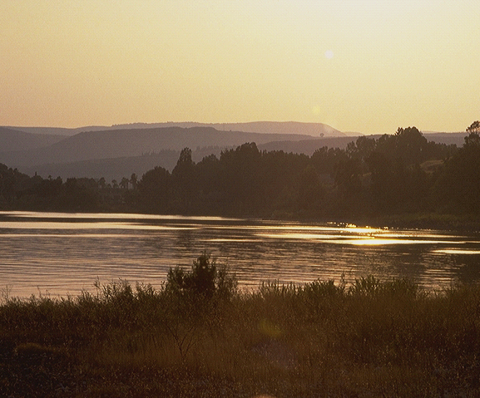
7
Gen. 15:6
ABRAHAM BELIEVES GOD'S PROMISE: A LAND, A SEED, AND A BLESSING!
_{LAND}
_{SEED,}
_{BLESSING}
Genesis 15:6!
God counts belief as righteousness on Abraham's part!
Just simple belief!
ABRAHAM
The CALL
L - S - B
Handbook pg. 19-24
23
3
Notes:
Yes…ABRAHAM continues to believe God's promise of a LAND, a SEED, and a BLESSING!
//// His simple unquestioning belief is told to us in Genesis 15:6...
//// …where God counts that BELIEF as righteousness on ABRAHAM's part.
//// Just simple belief! This is the first step in the new program of redemption God will introduce to the earth through His old friend.

Slide 21
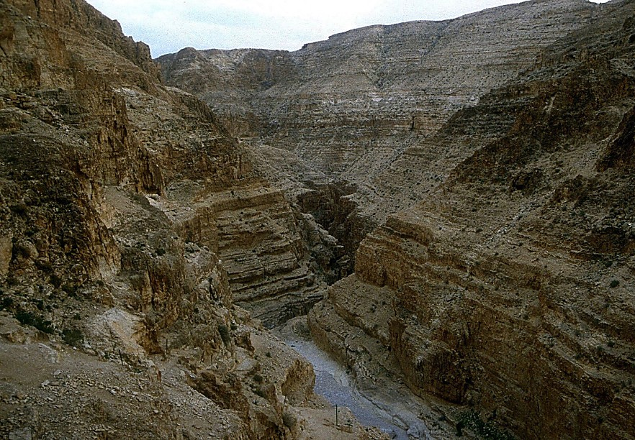
7
Gen. 16:1-4
ABRAHAM BELIEVES GOD!
Nevertheless: Abraham and Sarah become impatient.
“Abraham…go into Hagar!” (Sarah's maidservant)
ABRAHAM
The CALL
L - S - B
Handbook pg. 19-24
24
3
Notes:
//// Abraham truly believes that God will accomplish what He has promised. And the years pass.
//// In spite of God's clear promise…ABRAHAM and Sarah become impatient as they wait for the children God had promised would be coming. In her impatience,
//// Sarah suggests that ABRAHAM go in to her Egyptian servant girl, Hagar, hoping that through that union the promised child might be born. That was not unusual in the culture of their day.

Slide 22
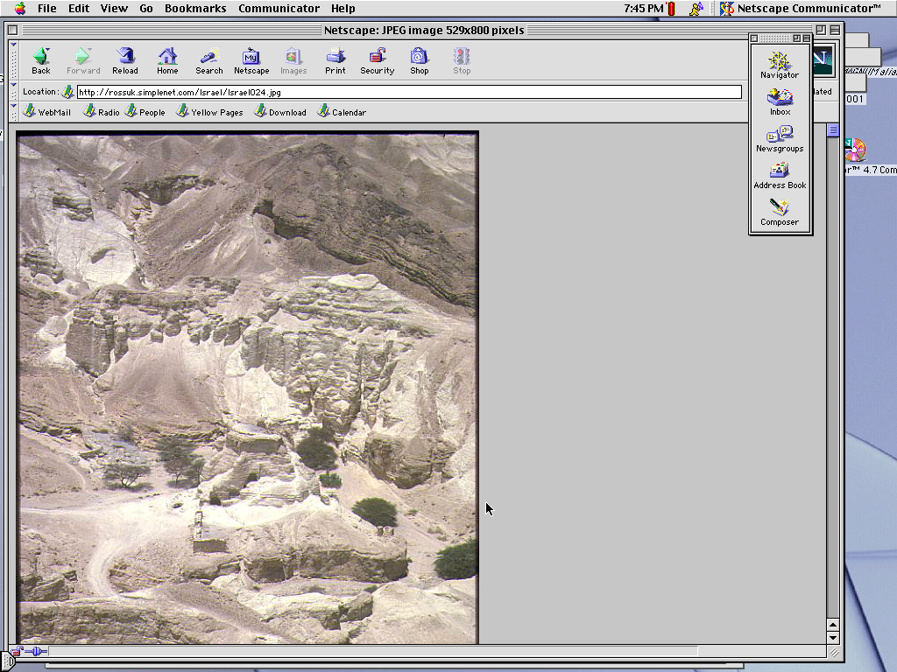
7
Gen. 16:11-12; 17:20-21
In time…Abraham fathers a son through Hagar.
His name: ISHMAEL
(ISHMAEL IS NOT THE SON OF THE PROMISE)
ABRAHAM
The CALL
L - S - B
Handbook pg. 19-24
25
3
Notes:
//// Indeed, in time...ABRAHAM does father a son through Hagar.
//// The boy is named ISHMAEL.
//// But, God says, the infant is not the intended son of His covenant Promise to Abraham's descendants.

Slide 23
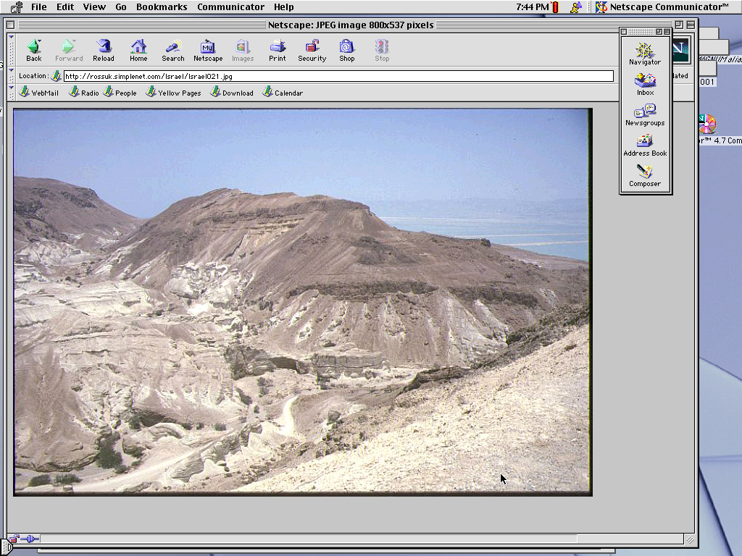
7
Gen. 17:19
By now…Abraham is 85 years old…Sarah is 75.
After another 15 years…
A son is actually born to ABRAHAM through SARAH.
NAME: “ISAAC”
ABRAHAM
The CALL
L - S - B
Handbook pg. 19-24
26
4
Notes:
//// By now, ABRAHAM is 85; Sarah, 75.
//// After another 15 years...
//// …the son of God's promise to ABRAHAM is finally born...through Sarah.
//// He is named ISAAC, a word that traces its meaning to the Hebrew root term indicating laughter. Yes, ABRAHAM thinks it hilarious that he and Sarah are to become parents at such advanced ages.

Slide 24
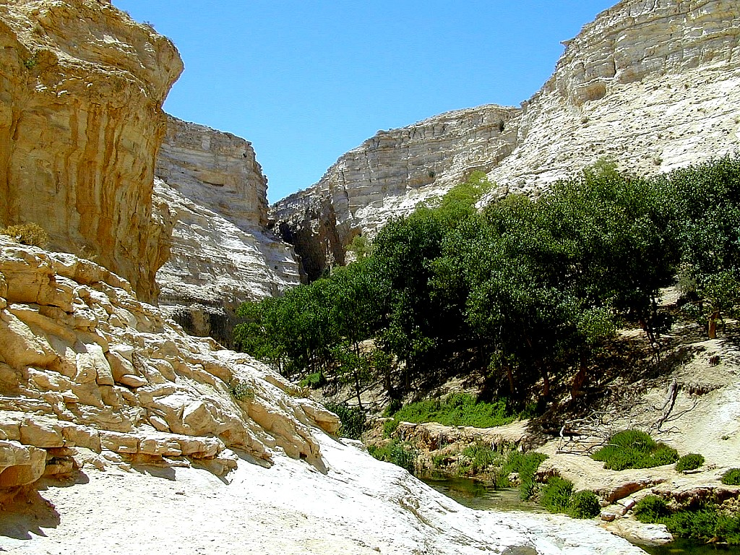
7
Gen. 17:21
Isaac is indeed the long-awaited son…
… through whom God's promise to Abraham is to be passed down…
ABRAHAM
The CALL
L - S - B
…THROUGH ISAAC'S FAMILY LINE!
Handbook pg. 19-24
27
2
Notes:
ISAAC is indeed the long-awaited son…
//// …through whom God's promise to ABRAHAM is to be passed down…
//// …through HIS family line.

Slide 25

7
Gen. 17
ABRAHAM
ABRAHAM
ca. 2000 B.C.
The CALL
AC
L - S - B
AJMJ
I - I
Gen. 12:1-3
ABRAHAM
The CALL
L - S - B
I - I
ISHMAEL & ISAAC
Handbook pg. 19-24
28
Notes:
So…the letters I and I appear on ABRAHAM's file folder. From these two sons of Abraham….ISHMAEL and ISAAC...
right here at this crucial historic point…the terrible Jewish-Arab conflict of our own time begins some 4,000 years ago...around 2000 B.C.

Slide 26
7
ABRAHAM
ABRAHAM
ca. 2000 B.C.
The CALL
AC
L - S - B
AJMJ
I - I
Gen. 12:1-3
ABRAHAM
The CALL
L - S - B
I - I
ARABIC PEOPLES
THROUGH ISHMAEL
JEWISH PEOPLE
THROUGH ISAAC
Handbook pg. 19-24
29
2
Notes:
Because...
//// …ISHMAEL is recognized today as the father of the Arab nations…through ABRAHAM…
//// while ISAAC, of course, is revered as one of the founding patriarchs of the Jews…also through ABRAHAM!

Slide 27
7
ABRAHAM
ABRAHAM
ca. 2000 B.C.
The CALL
AC
L - S - B
AJMJ
I - I
Gen. 12:1-3
ABRAHAM
The CALL
L - S - B
I - I
ARABIC PEOPLES
THROUGH ISHMAEL
JEWISH PEOPLE
THROUGH ISAAC
Handbook pg. 19-24
30
Notes:
There is enormous conflict between the two half-brothers and their mothers. And as we watch or read today's news, we see that that age-old turmoil begun in ABRAHAM's tent 4,000 years ago continues today! Both the Jews and the Arabs claim ABRAHAM as the beginning point of their respective peoples!

Slide 28
7
Gen. 22:2; 2 Chr. 3:1
WHICH SON?
“Then God said, “Take your son, your only son, Isaac, whom you love, and go to the region of Moriah. Sacrifice him there as a burnt offering, on one of the mountains I will tell you about.” Genesis 22:2
ABRAHAM
The CALL
L - S - B
I - I
NIV study note: :”In the Hebrew text, “Isaac” follows the clause “whom you love,” in order to heighten the effect: “your son, your only son, whom you love -- Isaac.” Isaac was the only “son of the Promise.”
2 Chr 3:1 The author identifies this site with the Temple mount [locating today's Dome of the Rock].
Handbook pg. 19-24
31
3
Notes:
The question then arises: how do we know WHICH SON was REALLY the inheritor of the Abrahamic promises? Look at Genesis 22:2…
//// “The God said, “Take your son, your only son, Isaac, whom you love, and go to the region of Moriah. Sacrifice him there as a burnt offering, on one of the mountains I will tell you about.”
//// Look at this study note from the NIV translation: “In the Hebrew text, “Isaac” follows the clause “whom you love,” in order to heighten the effect: “your son, your only son, whom you love – Isaac.” Isaac was the only “son of the Promise.”
//// Here also, you'll find in Second Chronicles 3:1 that God identifies Moriah with the Temple mount, which, today, is the site of the Moslem Dome of the Rock.” Much more on that location a little later.

Slide 29
7
Gen. 17:20-21
WHICH SON?
“And as for Ishmael, I have heard you. Behold I have blessed him, and will make him fruitful, and will multiply him exceedingly. He shall beget twelve princes, and I will make him a great nation. But My covenant I will establish with Isaac, whom Sarah shall bear to you at this set time next year.”
Gen 17:20-21 (NKJV)
ABRAHAM
The CALL
L - S - B
But My covenant I will
I - I
establish with Isaac
Handbook pg. 19-24
32
2
Notes:
But Ishmael was not forgotten…not at all!
//// Genesis 17: 20-21…”And as for Ishmael, I have heard you. Behold I have blessed him, and will make him fruitful, and will multiply him exceedingly. He shall beget twelve princes, and I will make him a great nation.
//// But My covenant I will establish with Isaac, whom Sarah shall bear to you at this set time next year.”

Slide 30
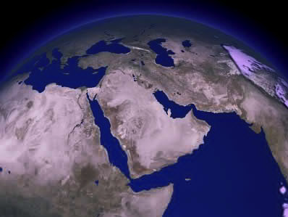
COMPARE THE GIFTS TODAY…
ISAAC
ABRAHAM
ISHMAEL
The CALL
L - S - B
WHY THE ENORMOUS DIFFERENCE?
I - I
Handbook pg. 19-24
33
3
Notes:
It's interesting to compare those gifts today…
//// Generally speaking…here are the lands populated today by the descendants of Ishmael…the Arab lands of the Middle East.
//// But then…compare that with the descendants of Isaac in the Middle East…right there in tiny Israel.
//// Why the enormous difference?

Slide 31
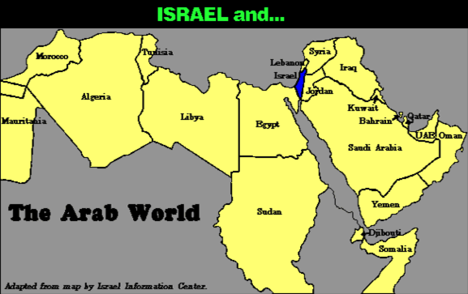
7
COMPARE THE GEOGRAPHY…
ABRAHAM
The CALL
L - S - B
I - I
Handbook pg. 19-24
34
Notes:
Practically speaking…just compare the geography…today's Israel versus the rest of the Arab world!

Slide 32
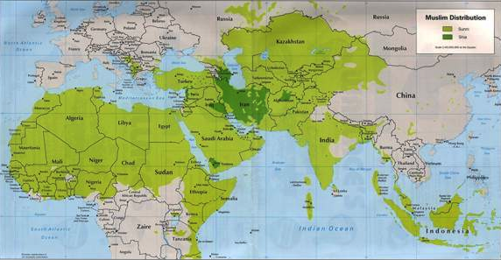
7
COMPARE THE GEOGRAPHY…
ABRAHAM
The CALL
L - S - B
I - I
MOHAMMED VERSUS ISAAC!
Handbook pg. 19-24
35
Notes:
But there is something else at work here. Compare the Middle Eastern influence of Ishmael's descendant, Mohammed, founder of Islam…with that of Isaac, the great Israelite patriarch, and the brother of Ishmael!

Slide 33
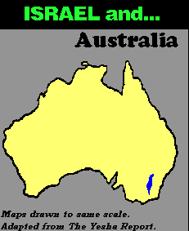
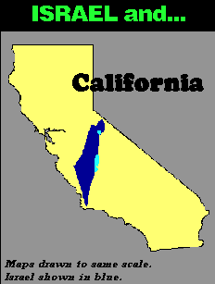
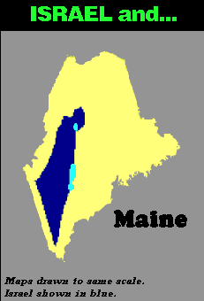
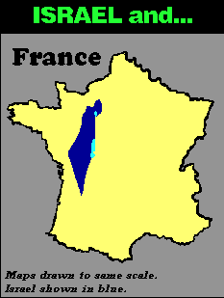
7
COMPARE THE GEOGRAPHY…
ABRAHAM
The CALL
L - S - B
I - I
Handbook pg. 19-24
36
3
Notes:
In today's geopolitical world…compare the size of tiny Israel with
Australia…
//// Israel with France…
//// Israel and the United States' state of Maine…or
//// Israel and California.

Slide 34
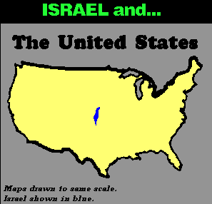
7
THE UNITED STATES
ABRAHAM
The CALL
L - S - B
I - I
DOES THIS SEEM FAIR?
Handbook pg. 19-24
37
Notes:
And finally…even when Israel is compared to the entire United States…from the north to the south…from east to west: when it comes to size alone, there is enormous disparity between Isaac and Ishmael! Why is this so? How can we explain it?

Slide 35
7
“…the Ishmaelites were given more land and ultimately more wealth than Israelites. This was true in their past history, not to mention the vast oil wealth of modern times. And spiritual salvation has always been open to the Ishmaelites.
ABRAHAM
The CALL
L - S - B
I - I
Hal Lindsey, “The Everlasting Hatred: The Roots of Jihad,” 2002, Pg 65
Handbook pg. 19-24
38
Notes:
Look at this passage from Hal Lindsay's recent book, The Everlasting Hatred: The Roots of Jihad:
“…the Ishmaelites were given more land and ultimately more wealth than Israelites. This was true in their past history, not to mention the vast oil wealth of modern times. And spiritual salvation has always been open to the Ishmaelites.”
[Continue to the next part of the passage below.]

Slide 36
7
“…the Ishmaelites were given more land and ultimately more wealth than Israelites. This was true in their past history, not to mention the vast oil wealth of modern times. And spiritual salvation has always been open to the Ishmaelites.
But God's covenant, which concerned His spiritual purposes, was only for Isaac and his descendants. The physical blessings promised to Isaac were to facilitate God's spiritual call for the nation that would come from him.” [Emphasis added]
ABRAHAM
The CALL
L - S - B
I - I
Hal Lindsey, “The Everlasting Hatred: The Roots of Jihad,” 2002, Pg 65
Handbook pg. 19-24
39
Notes:
“But God's covenant, which concerned His spiritual purposes, was only for Isaac and his descendants. The physical blessings promised to Isaac were to facilitate God's spiritual call for the nation that would come from him.”

Slide 37
7
LEBANON
DESCENDANTS OF ISAAC
Mediterranean Sea
SYRIA
Sea of Galilee
IRAQ
Haifa
Nazareth
Netanya
JORDAN
Tel Aviv-Jaffa
AMMAN
JERUSALEM
Jericho
Gaza
Hebron
Dead Sea
ABRAHAM
Beersheba
The CALL
ISRAEL
L - S - B
I - I
DESCENDANTS OF ISHMAEL
EGYPT
SAUDI ARABIA
Eilat
Al' Aqaba
Gulf of Aqaba
ISHMAEL & ISAAC IN TODAY'S ISRAEL
ISHMAEL & ISAAC IN TODAY'S ISRAEL
Handbook pg. 19-24
40
2
Notes:
And inside the ancient Land right now…
//// Here, the descendants of Isaac
//// and the descendants of Ishmael continue today -- that endless conflict begun in Abraham's tent in ancient Palestine or Canaan – or Israel -- so long ago. Jewish Israel is engulfed by the descendants of Ishmael in surrounding countries on all sides! The implications of that circumstance in our own day are enormous.

Slide 38
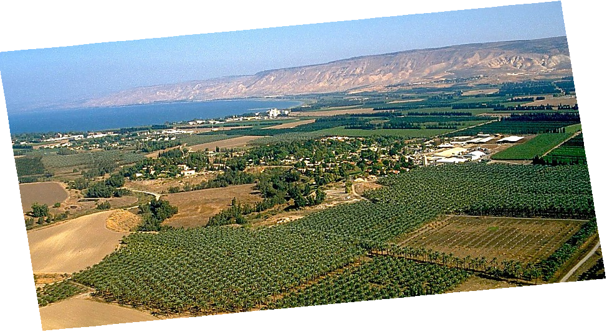
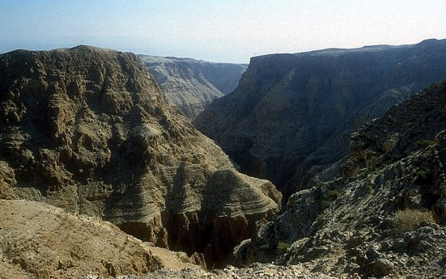
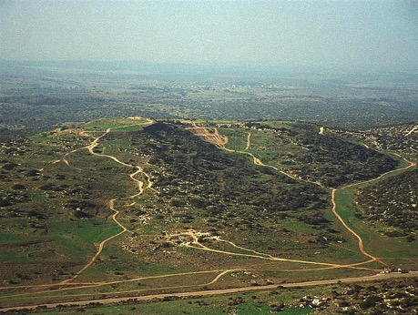
Gen. 13:10-11; Ex 3:8
A PORTION OF ABRAHAM'S PROMISE,,,
ABRAHAM
The CALL
L - S - B
I - I
THE MARVELOUS BEAUTY OF CANAAN…
THE LAND OF HIS ANCIENT INHERITANCE!
The Jordan River in Central Israel
Handbook pg. 19-24
© 2006 TBBMI
41
1
Notes:
And here is that Land today…but only a portion of God's promise to Abraham…this lush location along Israel's Jordan River.
//// the Land of his promised inheritance! From the fertile north to the desolate south…”milk and honey” are only the start of the blessings of this special piece of earth's real estate.

Slide 39
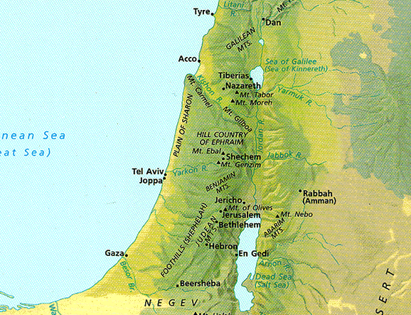



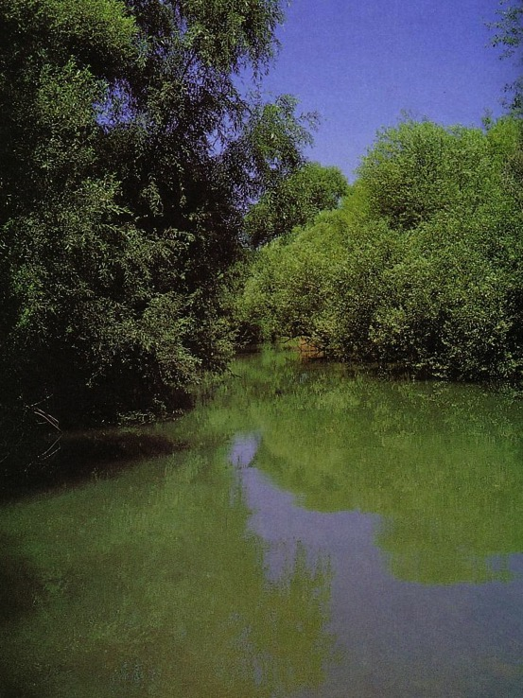
Bodies of Water in Israel
n.m. lyre -- lyre, stringed instrument used for popular as well as sacred music (B4604)
36
NT: Sea of Galilee
OT: Sea of Chinnereth
105 km. (65 mi.)
The Great Sea
215 km. (135 mi.)
Jordan River
Salt Sea
Nahal Senir, one of the sources of the Jordan River

Slide 40

Mountains in Israel
10
Hermon
Carmel
Tabor
Gilboa
Zion
Olives
Nebo
Hor

Slide 41
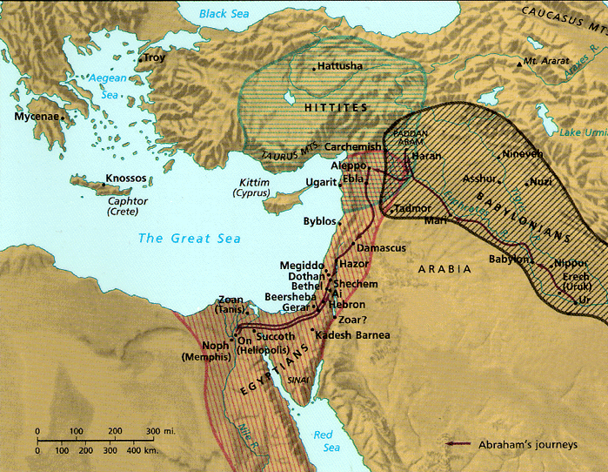
Israel's Strategic Location
34
Thought Question:
How has God placed you in a strategic place for His purposes?

Slide 42

From
“Dan to Beersheba”
Dan
36
Beersheba

Slide 43
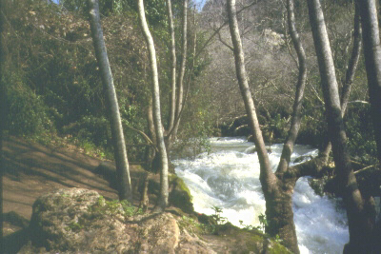

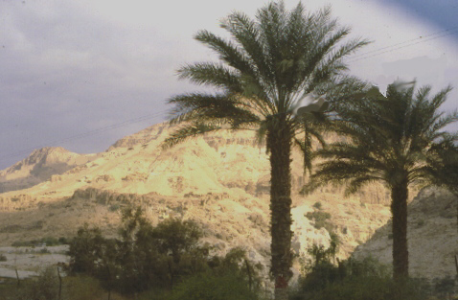
Extremities of the Land
Josh. 3:1-12:24
36
…from Dan in the North...
JOSHUA
Jericho/Ai
Land Divided
…to Beersheba in the South...
Handbook pg. 29-31
43

Slide 44
Regions of Israel (OT)
40
Bashan
Galilee
Israel
G
Gilead
A
Ammon
Judah
Moab
M
Edom
E

Slide 45
Petra

Slide 46


Geographical Setting
444
598d
Jacob
Israel
Esau
Edom

Slide 47
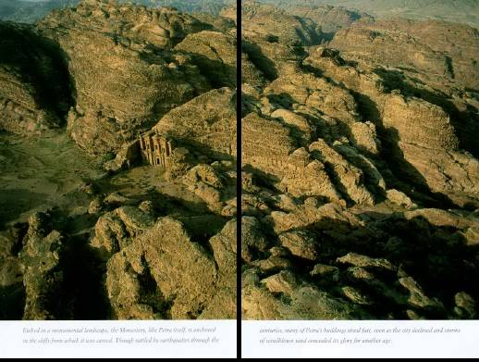
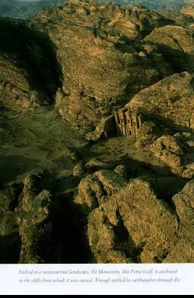
Imagine living in this terrain!

Slide 48
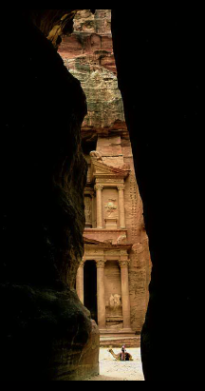
Who Lived at Petra?
Horites (Gen. 14:6):
Pre-1850 (“hill country of Seir”)
Edomites (Amos 1:12):
1850-552 BC (“Sela” Heb. “rock”)
Nabataeans (not in Bible)
552 BC-AD 106 (“Petra” Gr. “rock”)
Romans (post-NT)
Post-AD 106 (“Hadriana”)

Slide 49
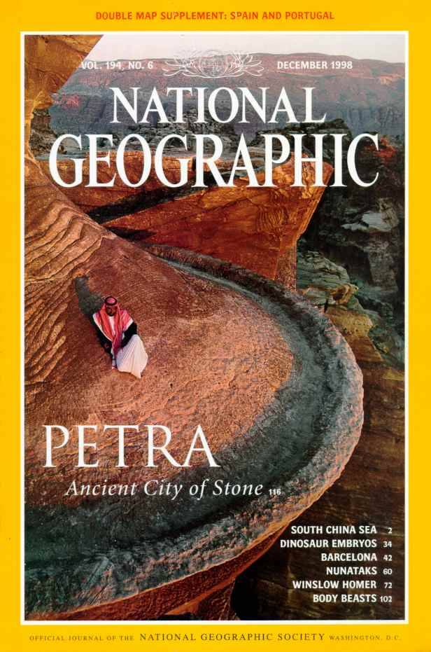
National Geographic has several articles on Petra back to 1907
Here's Dec. 1998

Slide 50
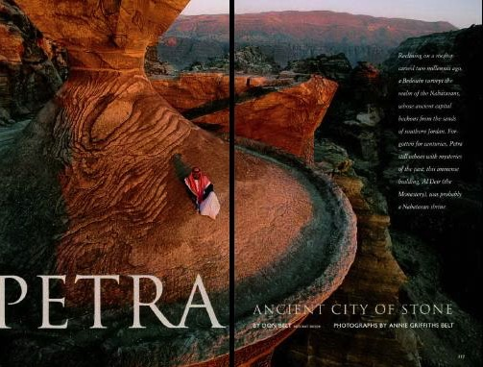
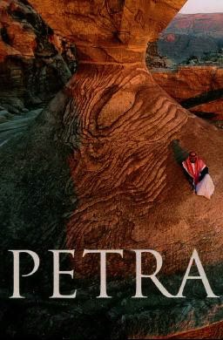
Petra Article Front Page
PETRA

Slide 51
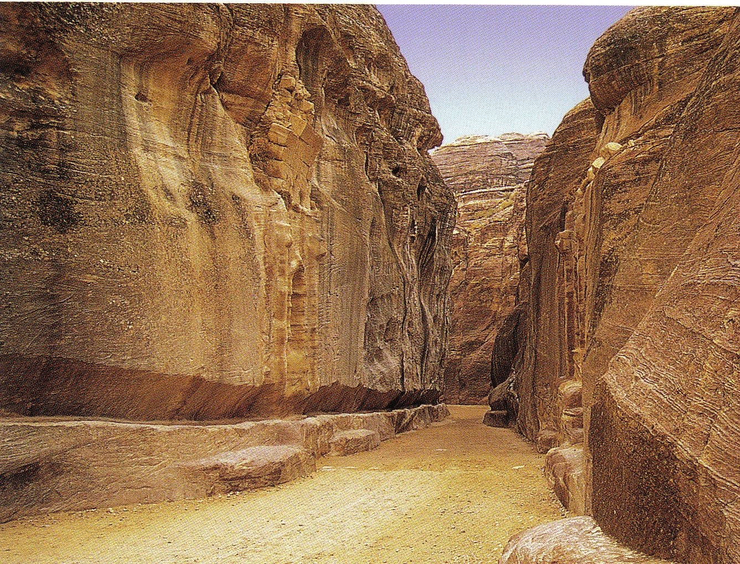
The Siq
(pronounced “seek”)
598c
The only entrance to Petra
Water Course

Slide 52
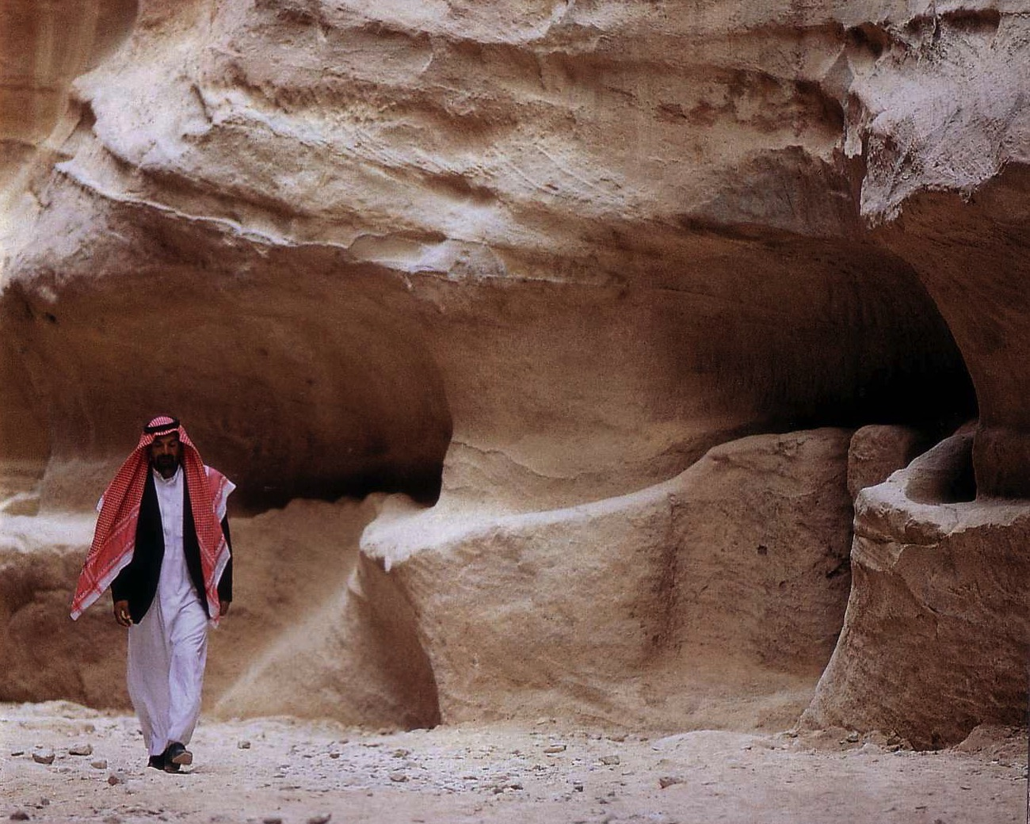
Water channels were buried for centuries

Slide 53
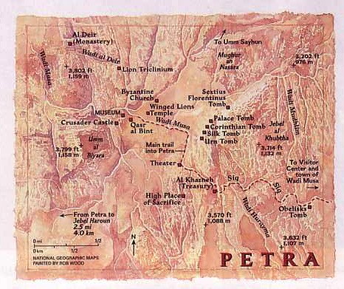
Petra Map
PETRA

Slide 54
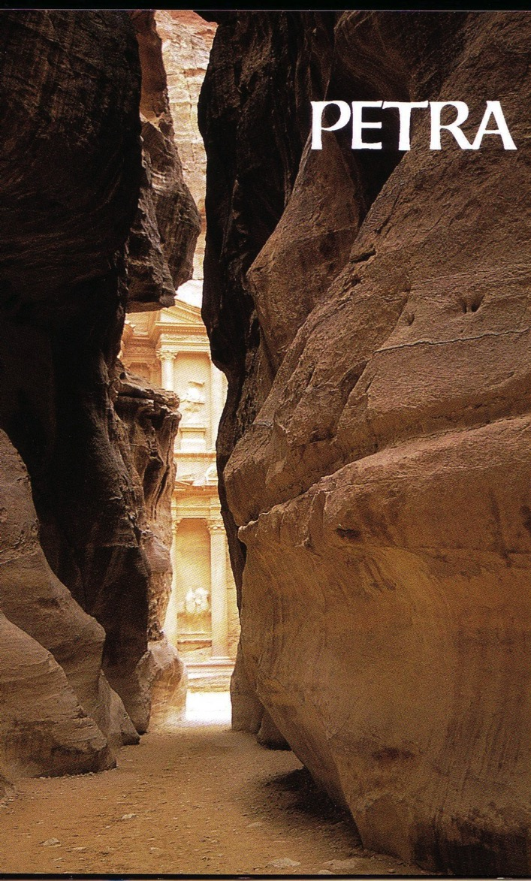
Exit of the Siq
598b

Slide 55
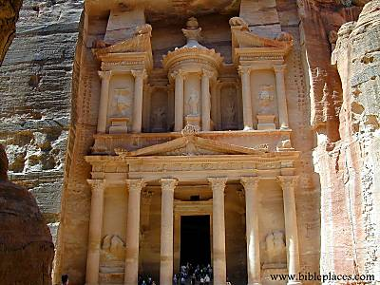
The Treasury
598b

Slide 56
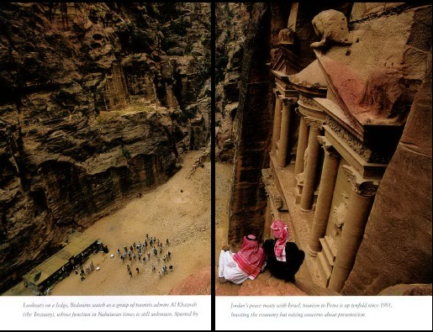
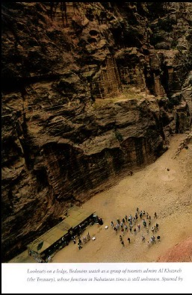
From atop the Treasury
Exit of
the Siq

Slide 57
Petra Map
PETRA

Slide 58
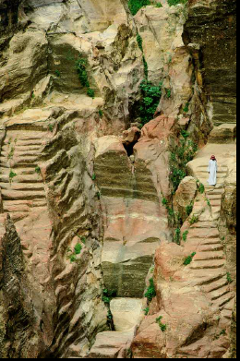
Nabataean engineers ingeniously collected the mere 6 inches of annual rainfall.

Slide 59
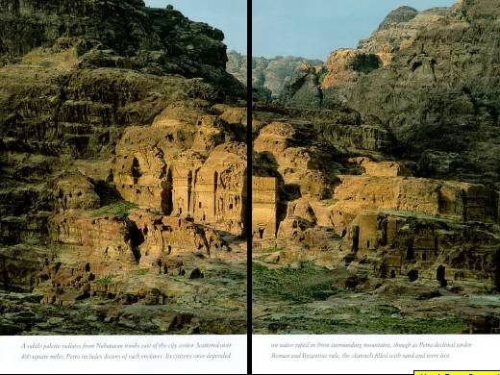
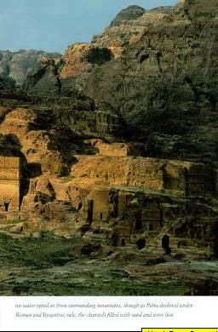
Nabataean tombs east of the city center

Slide 60
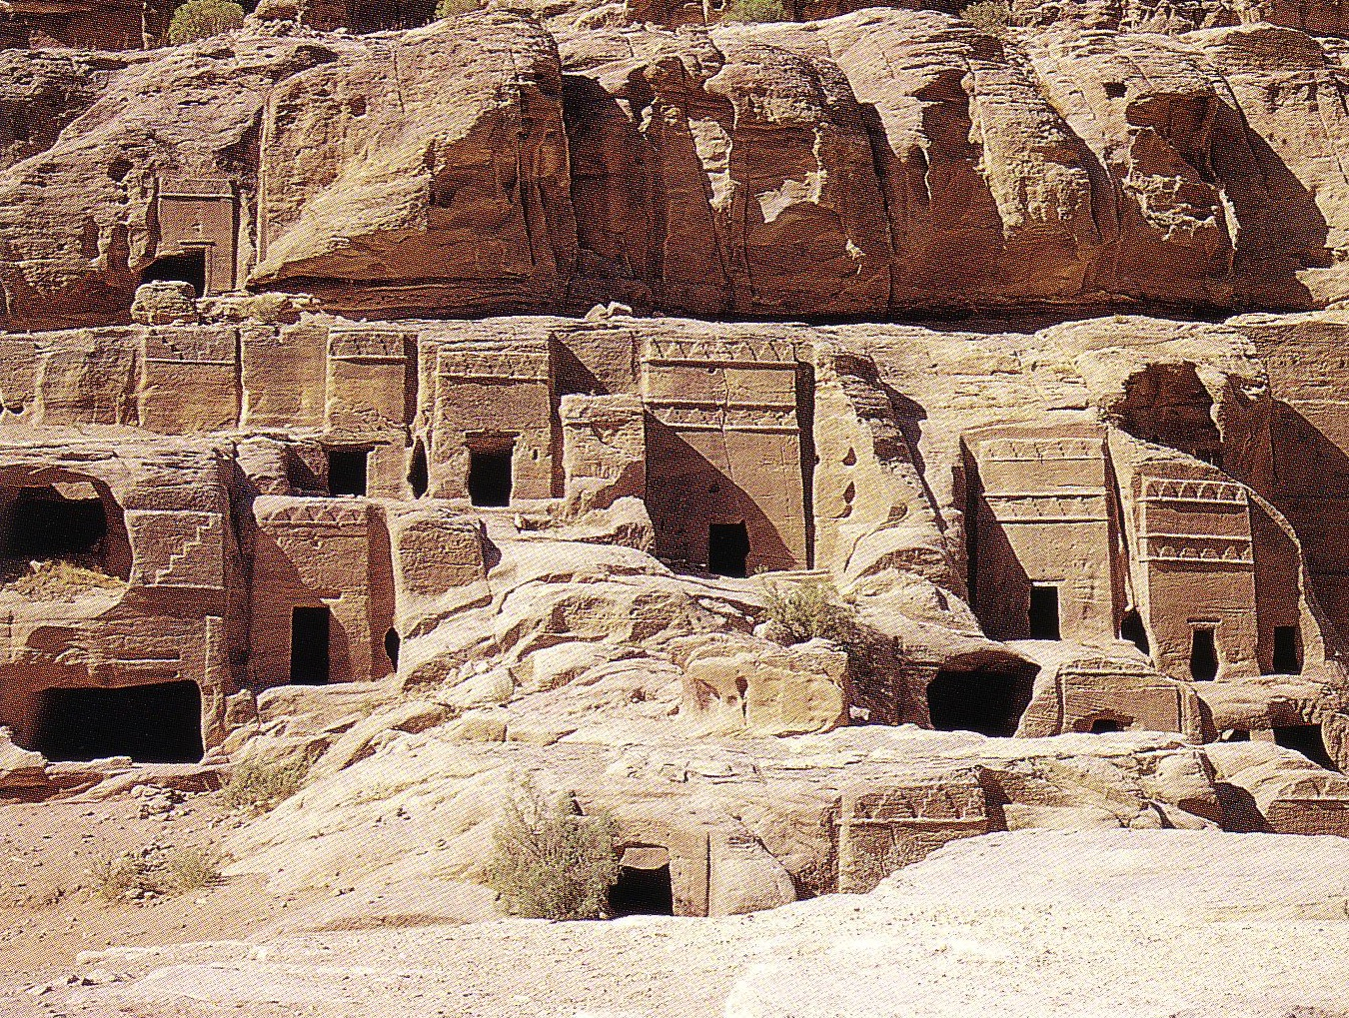
The pride of your heart has deceived you, you who live in the clefts of the rock [Heb. “sela”], in your lofty dwelling, who say in your heart,
"Who will bring me down to the ground?" (Obad. 3)
598c

Slide 61
Petra Map
PETRA

Slide 62
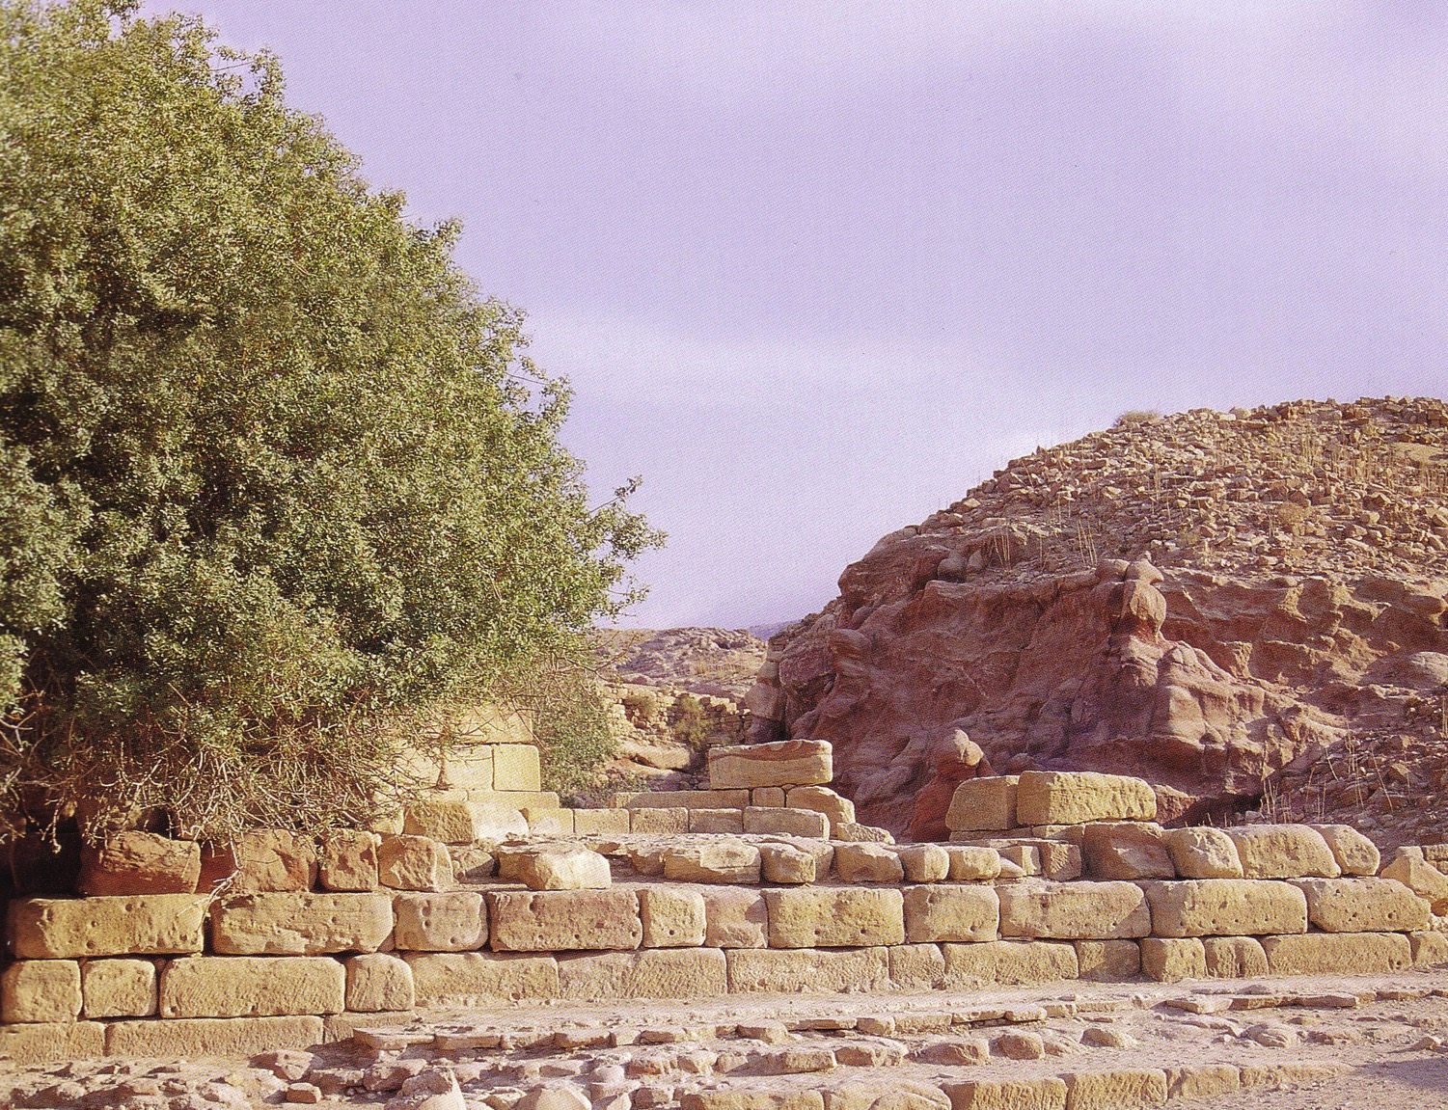
Nymphaleon

Slide 63
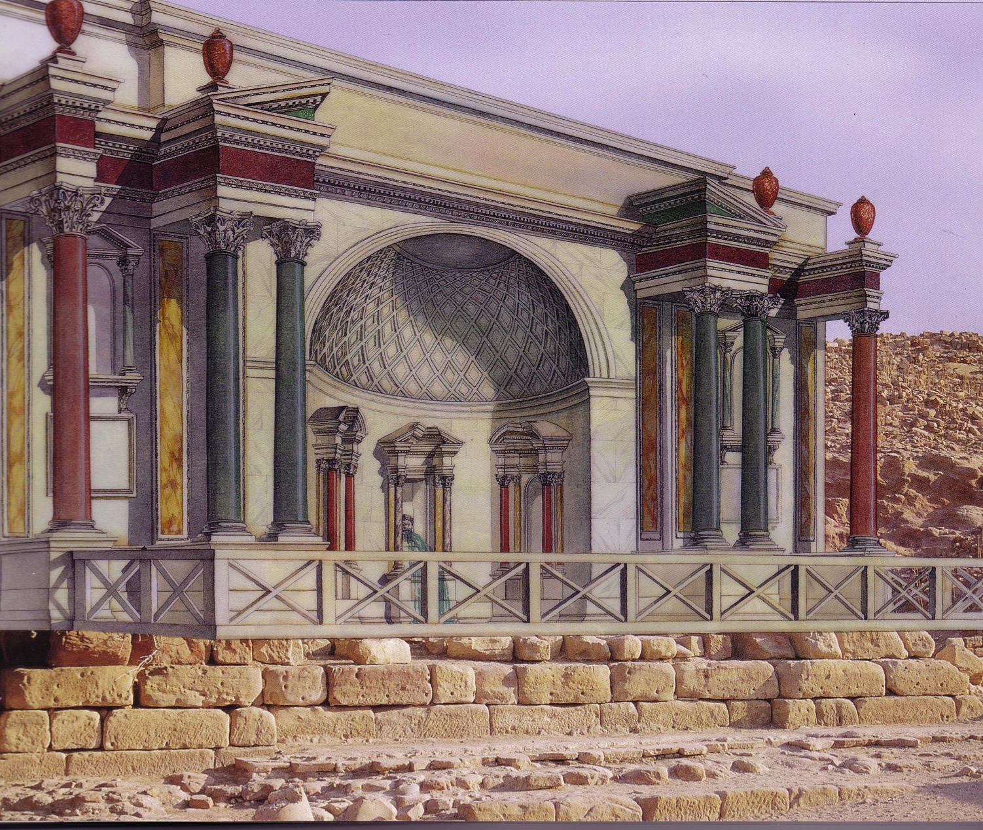
Nymphaleon

Slide 64
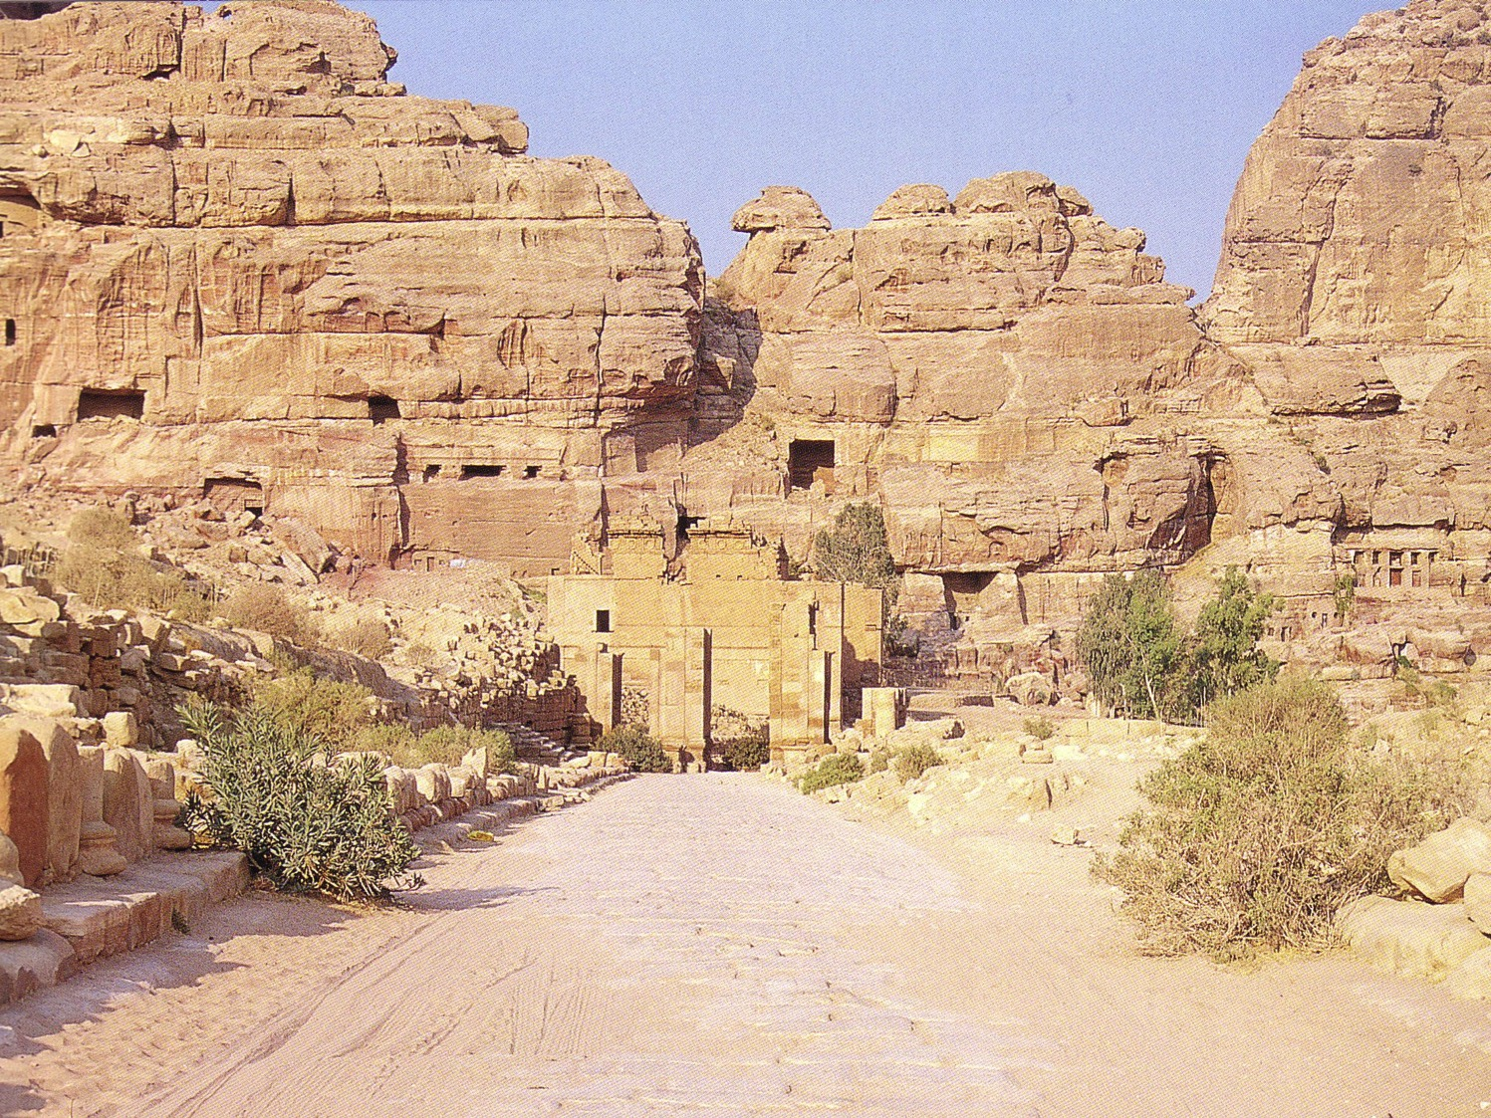
Colonnade Envisioned
598c

Slide 65
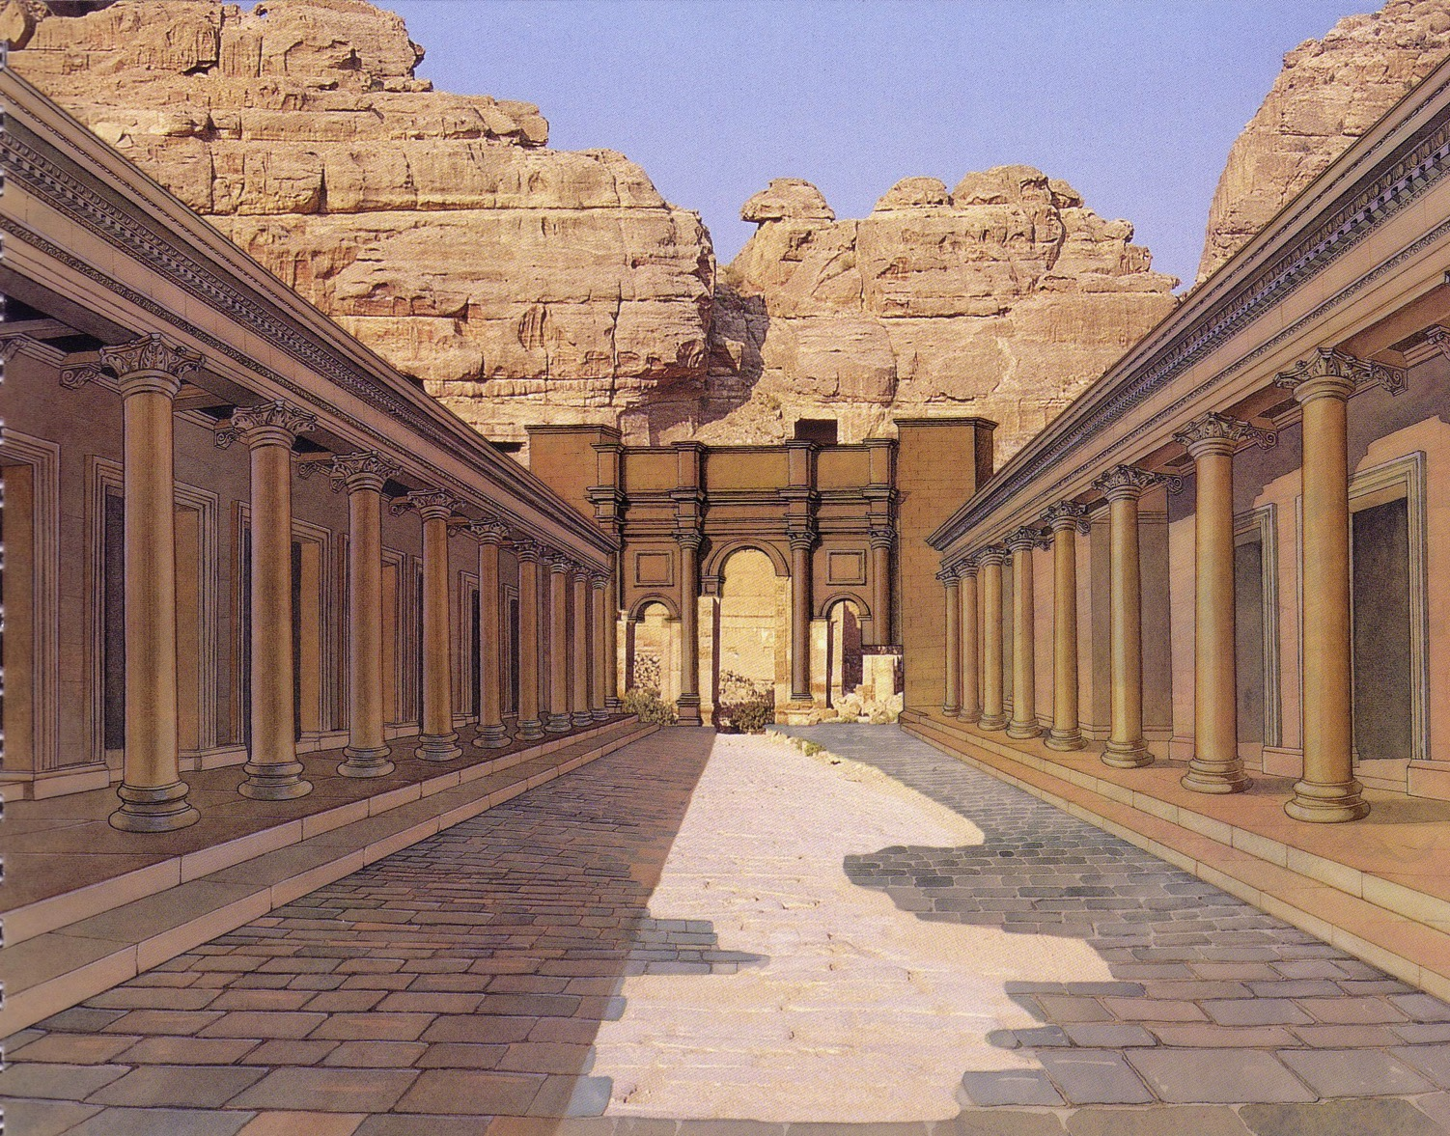
Colonnade Realized
598c

Slide 66
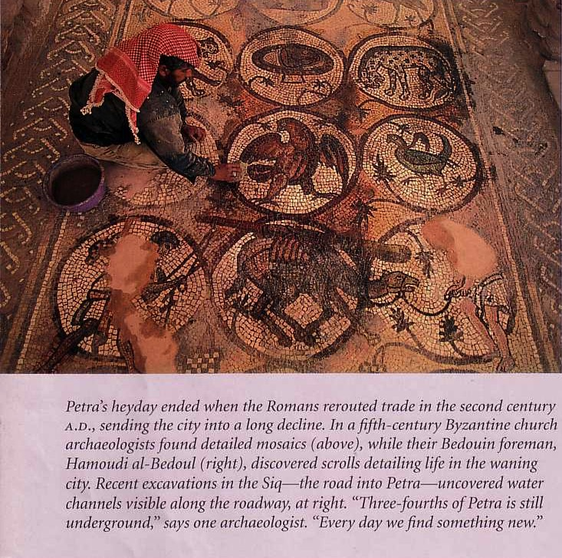
Byzantine Church Mosaic (5th century)

Slide 67
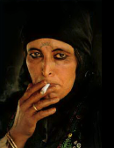


Bread-making Bedouins still live at Petra

Slide 68
Egypt to Mesopotamia Trade

Slide 69

The King's Highway
54
Petra
Barry Beitzel,
Moody Atlas of Bible Lands, 87

Slide 70
The Spice Trade
Petra

Slide 71
Black

Slide 72


Bible Geography link at BibleStudyDownloads.org
Get this presentation for free!
Notes:
Bible Geograhpy (bg)

